Slide 1

N-Gram Languages Model

Slide 2
Contents
Introduction
Unigrams and Bigrams
Limitations
Trigram and Higher N-Grams
Applications of N-Gram Language Model

Slide 3
Introduction
N-Gram models are statistical language models used in NLP. They estimate the likelihood of a sequence of N words based on their frequency in data. "N" represents the number of words grouped together.
For instance, in a bigram (2-gram) model, the probability of a word depends on the previous word. These models are simple but struggle with understanding complex language patterns compared to modern models like RNNs and transformers.

Slide 4
Introduction
Example
Dataset with the following sentences
"I love to eat ice cream."
"I love to play soccer."
"I prefer tea over coffee.“
If we want to create a bigram (2-gram) model, we'll look at pairs of consecutive words in each sentence. For example, the first sentence would be split into these bigrams:
"I love"
"love to"
"to eat"
"eat ice"
"ice cream"

Slide 5
Unigrams and Bigrams
Unigrams (1-grams):
Unigrams are the simplest form of N-Grams, where each word or token in a text is treated as a separate unit, and its probability is calculated independently of other words. In other words, unigrams don't take into account any context or relationship with surrounding words.
Bigrams (2-grams):
Bigrams are a type of N-Gram where words are grouped into pairs, and the probability of a word depends on the previous word. This introduces a basic level of context into the model. Bigram models consider the likelihood of observing a word given the word that immediately precedes it.

Slide 6
Unigrams and Bigrams
Example
"I love to eat ice cream.“
Unigrams: each word's probability is calculated separately. So, for each word: P("I"), P("love"), P("to"), P("eat"), P("ice"), P("cream").
Bigrams: the probabilities of words are calculated based on their relationship with the preceding word. P("I love"), P("love to"), P("to eat"), P("eat ice"), P("ice cream").

Slide 7
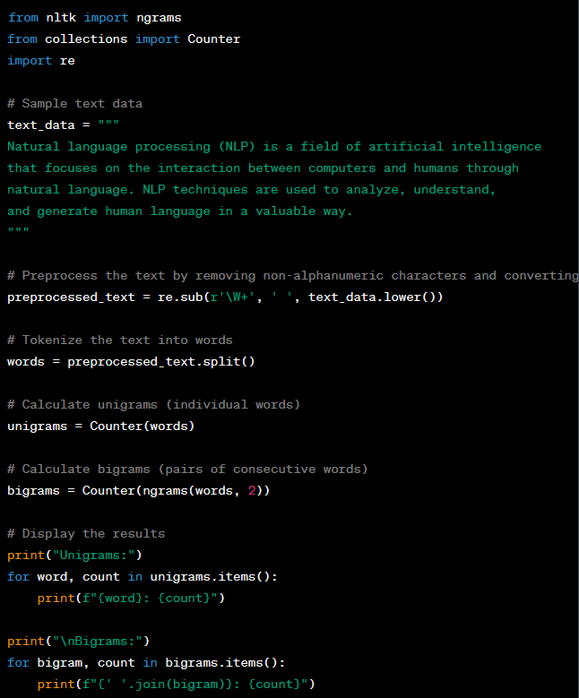
Example in Python
In this example, the code performs the following steps
Preprocess the text by removing non-alphanumeric characters and converting it to lowercase.
Tokenize the text into individual words.
Calculate the frequency of each unigram (individual word) using the Counter class.
Calculate the frequency of each bigram (pair of consecutive words) using the ngrams function and the Counter class.
Display the results for both unigrams and bigrams.

Slide 8
Limitations
Using only unigrams and bigrams in language modeling has several limitations
Lack of Context Beyond Adjacent Words
Ignoring Long-Range Dependencies
Limited Understanding of Nuanced Language Patterns
Difficulty with Ambiguity
Poor Performance on Tasks Requiring Deep Semantics
Inadequate for Creative Text Generation

Slide 9
Trigrams, Higher N-Grams
Trigrams (3-grams) and higher N-Grams are extensions of the N-Gram language modeling concept.
While bigrams consider pairs of adjacent words, trigrams consider sequences of three consecutive words, and higher N-Grams consider sequences of N words, where N is greater than 3.
These models aim to capture more intricate language patterns by considering a broader context within the text.

Slide 10
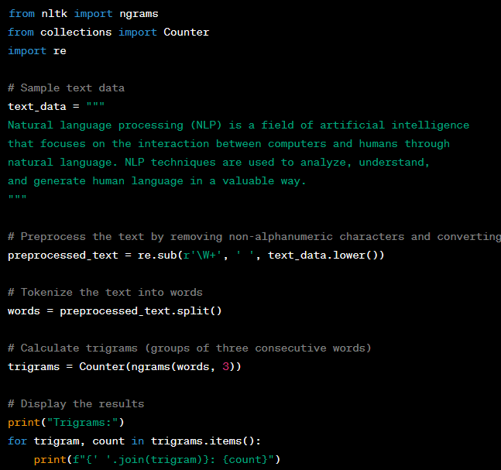
Example in Python
In this example, the code performs the following steps:
Preprocess the text by removing non-alphanumeric characters and converting it to lowercase.
Tokenize the text into individual words.
Calculate the frequency of each trigram (group of three consecutive words) using the ngrams function and the Counter class.
Display the results for trigrams.

Slide 11
Applications
Speech Recognition
Machine Translation
Text Generation
Language Modeling
Spell Checking and Correction
Information Retrieval
Predictive Text Analytics

Slide 12
Summary
While N-Gram models offer simplicity and efficiency, they are best suited for tasks that require basic language understanding and context prediction.
For more advanced applications that demand nuanced understanding and generation of text, modern models like RNNs, LSTMs, and transformer-based models have proven to be more effective due to their ability to capture long-range dependencies and semantic relationships in language.

Slide 13
Practice on N-Gram Models
Instructions
  Create a Python program that builds an N-Gram language model from a given text and generates text based on the model.
  You'll work with a dataset containing sample text.
  Your task is to build a simple N-Gram language model and use it to generate text.
Dataset
  text_data = """Natural language processing (NLP) is a field of artificial intelligence that focuses on the interaction between computers and humans through natural language. NLP techniques are used to analyze, understand, and generate human language in a valuable way."""

Slide 14
Practice on N-Gram Models
Tasks
  Task 1: Preprocessing
    Write a function preprocess_text(text) that takes a text as input and preprocesses it by converting to lowercase and removing non-alphanumeric characters.
  Task 2: Build N-Gram Model
    Write a function build_ngram_model(text, n) that takes preprocessed text and the value of n (order of the N-Gram) as input, and builds an N-Gram language model.
  Task 3: Generate Text
    Write a function generate_text(model, seed, length) that takes the N-Gram model, a seed (starting word or phrase), and the desired length of the generated text as input, and generates text using the N-Gram language model.
  Task 4: Test Your Functions
    Apply each function to the given text_data and print the generated text using different seeds and lengths.

Slide 15
Q & A

